Slide 1
Flu Shot Learning
Team: I Love Data
Members: Els Dai, Jieru Shen, Yanjun Wan, Crystal Wu, Flora Zhang

Slide 2

Goal
Predict how likely individuals are to receive their H1N1 and seasonal flu vaccines

Slide 3
Agenda
1. Overview
2. Data Preprocessing
3. Models
4. Key Findings
5. Further Discussion

Slide 4
1.
Overview

Slide 5
Overview
Data provided by the US National Center for Health Statistics
35 predictor variables
2 dependent variables
Results may provide insights for future public health efforts

Slide 6
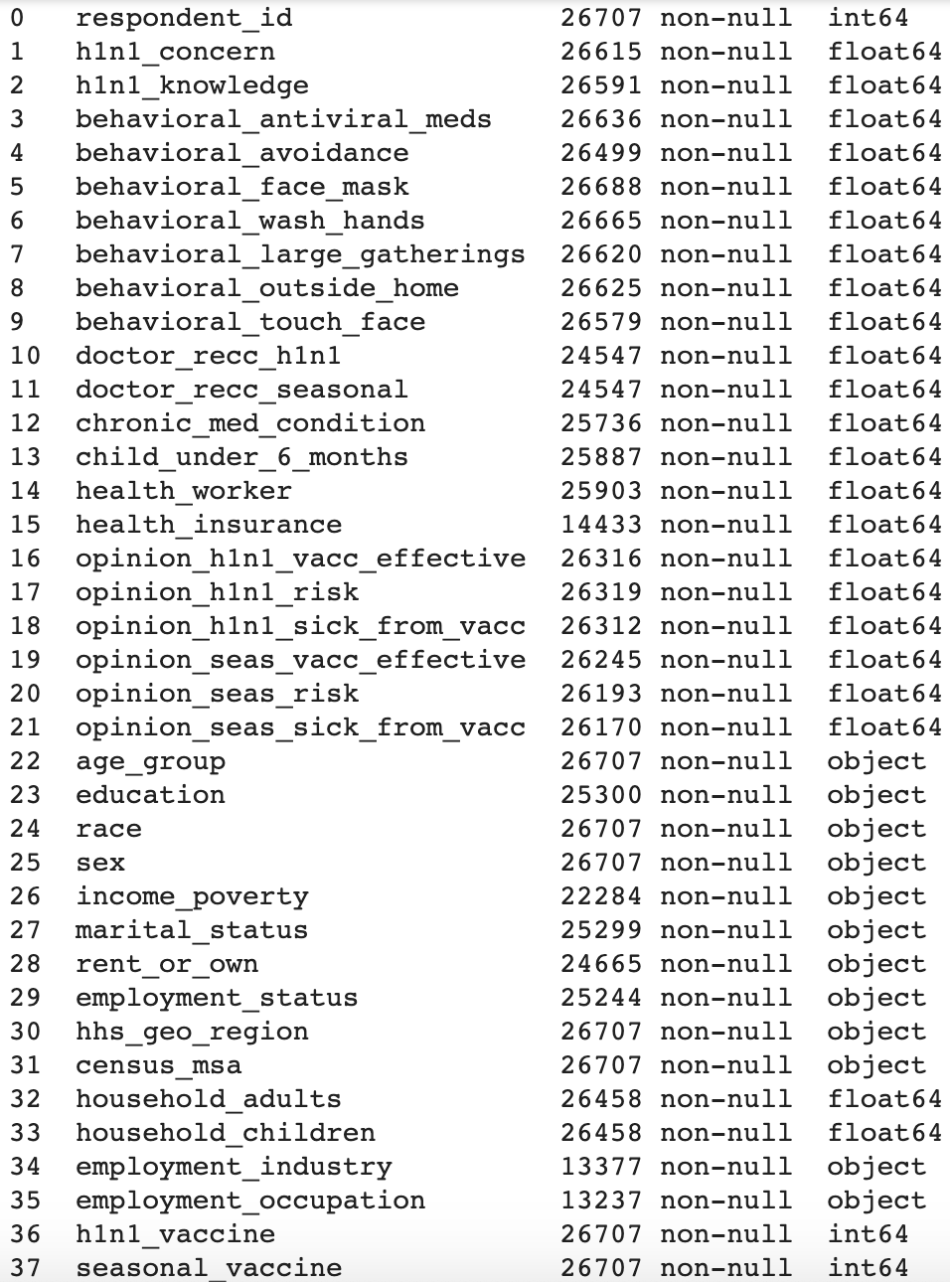
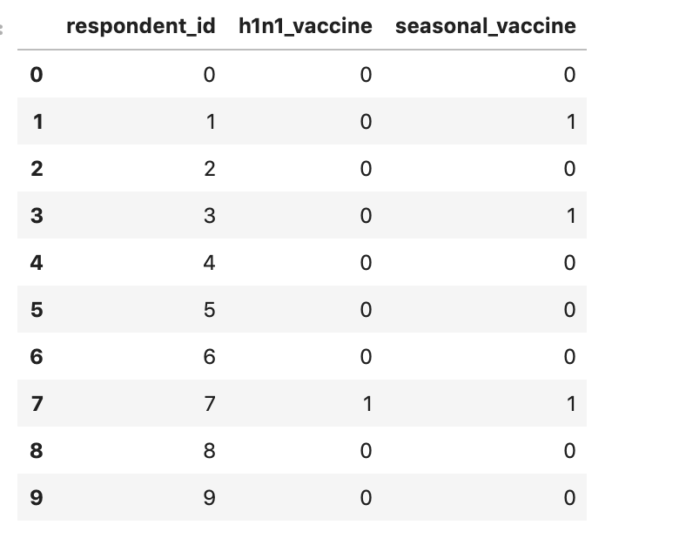
←List of features (predictor variables)
↓Whether the flu shot is taken

Slide 7
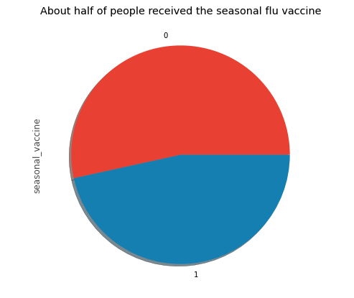
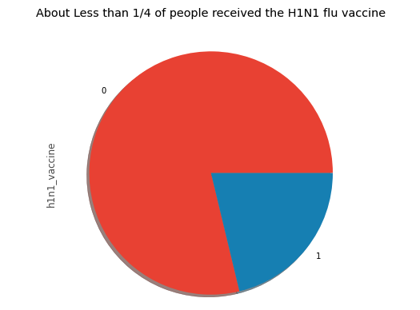
≈ ¼ people get the H1N1 flu shot
≈ ½ people get the seasonal flu shot

Slide 8
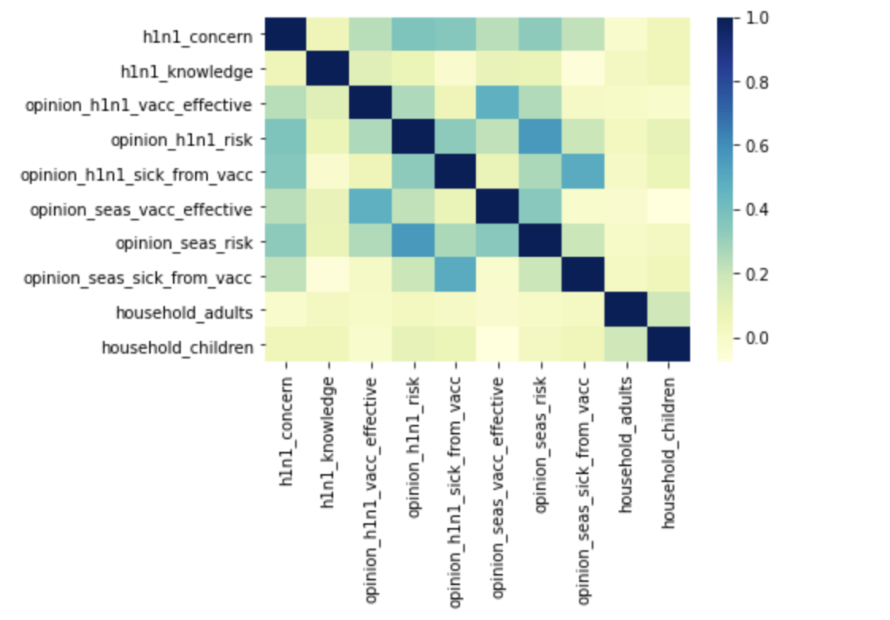
Correlation between numerical predictors

Slide 9
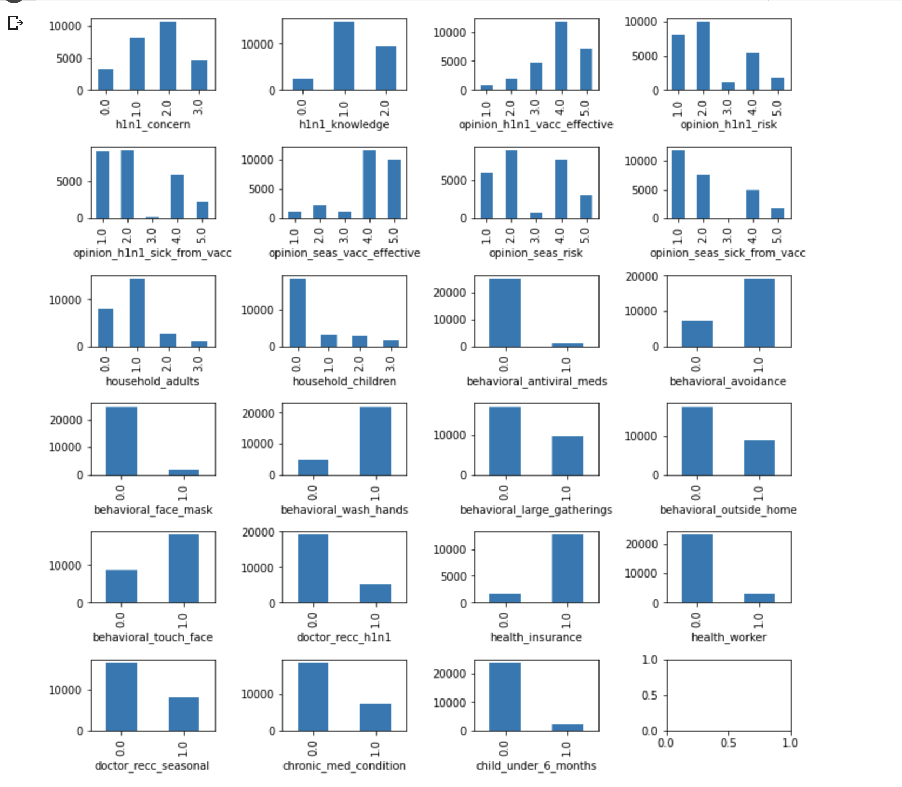
Distribution of Numerical Variables

Slide 10
2.
Data Preprocessing

Slide 11
Data Preprocessing
Drop Columns and Null Values:
Hhs_geo_region
Employment_industry
Employment_occupation
Health_insurance
Categorical Variables:
Convert categorical data to binary variables using one-hot encoding method
Age_group
Education
Race
Income_poverty
Sex
Marital_status
Rent_or_own
Employment_status
Census_msa
Numerical Variables:
Fill null values with the medians of the numerical variables
H1n1_concern
H1n1_knowledge
Opinion_h1n1_vacc_effective
Opinion_h1n1_risk
Opinion_h1n1_sick_from_vacc
Opinion_seas_vacc_effective
Opinion_seas_risk
Opinion_seas_sick_from_vacc

Slide 12
3.
Models

Slide 13
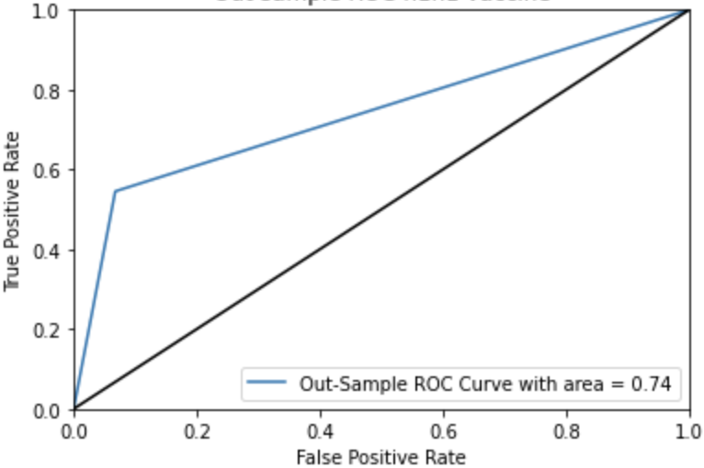
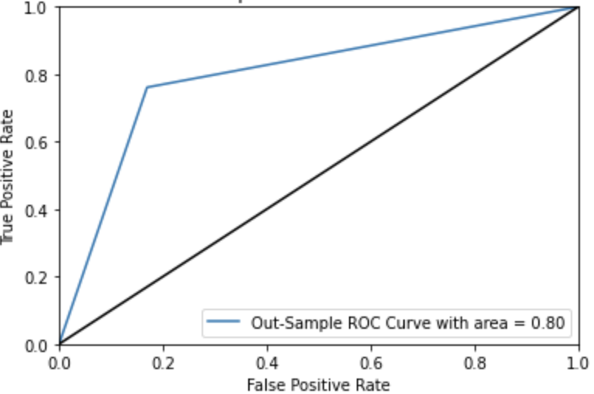
Logistic Regression
Model for H1N1 vaccine
Accuracy: 84.60%
Model for seasonal flu vaccine
Accuracy: 79.75%

Slide 14
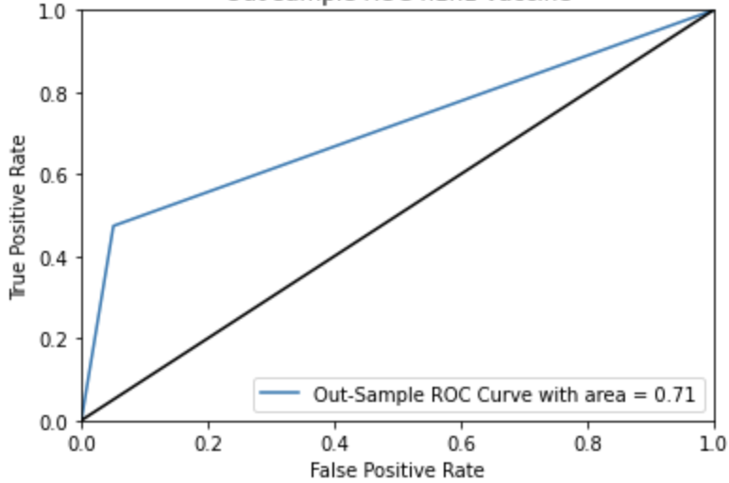
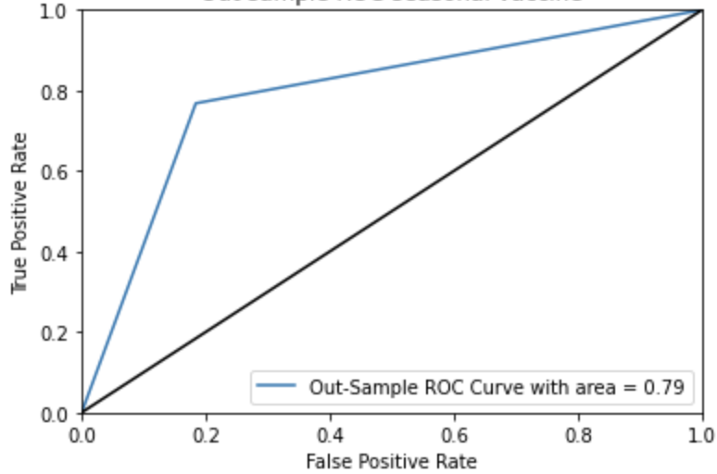
Random Forest
Model for H1N1 vaccine
Accuracy: 84.31%
Model for seasonal flu vaccine
Accuracy: 80.40%

Slide 15
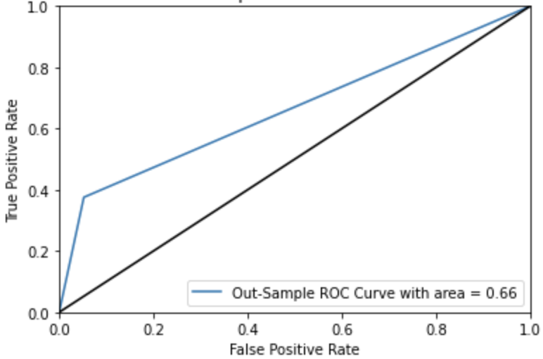
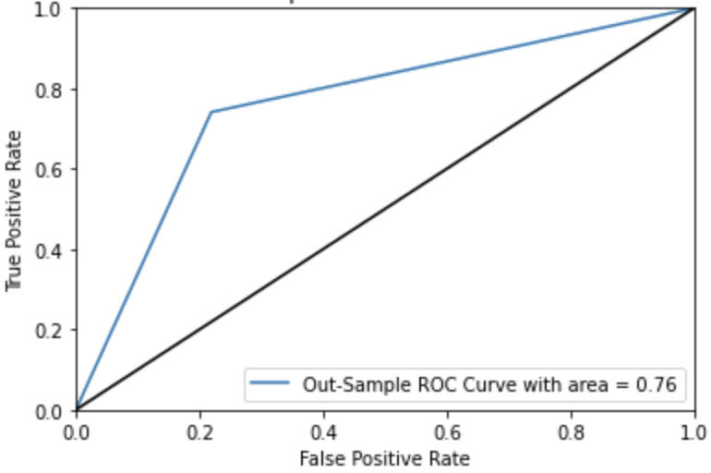
K-Nearest Neighbors (KNN)
Model for H1N1 vaccine
Accuracy: 81.99%
Model for seasonal flu vaccine
Accuracy: 60.73%

Slide 16
4.
Key Findings

Slide 17
Key Findings (Feature Importance)
Model with the highest accuracy and AUC: Logistic regression model
Model for H1N1 vaccine
Important features (coefficients):
Doctor_recc_h1n1
Seasonal_vaccine
Doctor_recc_seasonal (negative)
Health_worker
Opinion_h1n1_vacc_effective
Opinion_h1n1_risk
Child_under_6_months
Model for seasonal flu vaccine
Important features (coefficients):
H1n1_vaccine
Doctor_recc_seasonal
65+ Years
Doctor_recc_h1n1 (negative)
Health_worker
Opinion_seas_risk
Opinion_seas_vacc_effective

Slide 18
Key Findings
Whether an individual had received H1N1 or seasonal flu vaccine is a powerful predictor
People tend to listen to doctors’ recommendations to decide whether to receive vaccines
Similar to our intuitive assumptions, individuals who work in the healthcare industry, infants, or elderly people are more likely to receive vaccines
Individuals that are more opinionated about the infectious disease, such as its risk and the effectiveness of the vaccine, are also more likely to receive vaccines

Slide 19
5.
Further Discussion

Slide 20

Further Discussion
Limitation
Ambiguous criterion for ratings such as the level of concern for the disease
More input features such as occupations and medical checkups frequency can possibly add values to our models
Taking correlations between input features into consideration may improve model efficiency
Generalization
Our prediction models can potentially be utilized to predict the likelihood for people to receive COVID-19 vaccines, given sufficient data regarding individuals’ demographic information and viewpoints on COVID-19.

Slide 21
THANKS!
Any questions?

